Slide 1

Transaction Processing

Slide 2
Topics to be covered
Transaction concepts
Properties of transactions
Serializability of transactions
Testing for serializability
System recovery
Two-phase commit protocol
Recovery and atomicity
Log-based recovery
Concurrent executions of transactions and related problems
Locking mechanism
Solution to concurrency related problems
Deadlock
Two-phase locking protocol
Isolation
Intent locking

Slide 3
What is transaction?
A transaction is a sequence of operations performed as a single logical unit of work.
A transaction is a logical unit of work that contains one or more SQL statements.
Example of transaction
read (A)
A = A – 50
write (A)
read (B)
B = B + 50
write (B)
Works as a single logical unit
Transaction
Operations

Slide 4
Example:
Suppose an employee of bank transfers Rs 800 from X's account to Y's account. This small transaction contains several low-level tasks:
X's Account
Open_Account(X)
Old_Balance = X.balance
New_Balance = Old_Balance - 800
X.balance = New_Balance
Close_Account(X)
Open_Account(X)
Old_Balance = X.balance
New_Balance1 = Old_Balance - 800
Open_Account(Y)
Old_Balance = Y.balance
New_Balance2 = Old_Balance + 800
Y.balance = New_Balance1
X.balance = New_Balance2
Y's Account
Open_Account(Y)
Old_Balance = Y.balance
New_Balance = Old_Balance + 800
Y.balance = New_Balance
Close_Account(Y)

Slide 5
Operations of Transaction
Following are the main operations of transaction:
Read(X): Read operation is used to read the value of X from the database and stores it in a buffer in main memory.
Write(X): Write operation is used to write the value back to the database from the buffer.
Commit: It is used to save the work done permanently.
Rollback: It is used to undo the work done.
Let's assume the value of X before starting of the transaction is 4000.
The first operation reads X's value from database and stores it in a buffer.
The second operation will decrease the value of X by 500. So buffer will contain 3500.
The third operation will write the buffer's value to the database. So X's final value will be 3500.
But it may be possible that because of the failure of hardware, software or power, etc. that transaction may fail before finished all the operations in the set.
For example: If in the above transaction, the debit transaction fails after executing operation 2 then X's value will remain 4000 in the database which is not acceptable by the bank.
Let's take an example to debit transaction from an account which consists of following operations:
1. R(X);
2. X = X - 500;
3. W(X);

Slide 6
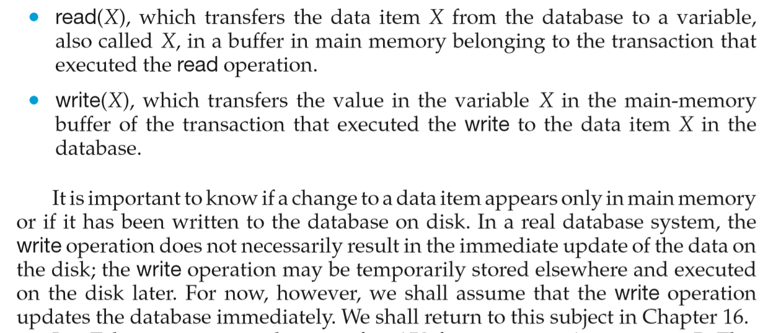
From the book:

Slide 7
ACID properties of transaction
Atomicity (Either transaction execute 0% or 100%)
Consistency (database must remain in a consistent state after any transaction)
Isolation (Intermediate transaction results must be hidden from other concurrently executed transactions)
Durability (Once a transaction completed successfully, the changes it has made into the database should be permanent)

Slide 8
ACID properties of transaction
1. Atomicity
This property states that a transaction must be treated as an atomic unit, that is, either all of its operations are executed or none.
Either transaction execute 0% or 100%.
For example, consider a transaction to transfer Rs. 50 from account A to account B.
In this transaction, if Rs. 50 is deducted from account A then it must be added to account B.
If transaction fails then the amount will be deducted from A but not added to B. This shows the inconsistent database state.
In order to ensure correctness of database state, the transaction must be executed in entirety.
read (A)
A = A – 50
write (A)
read (B)
B = B + 50
write (B)
0%
FAIL
100%

Slide 9
ACID properties of transaction
2. Consistency
The database must remain in a consistent state after any transaction.
If the database was in a consistent state before the execution of a transaction, it must remain consistent after the execution of the transaction as well.
In our example, total of A and B must remain same before and after the execution of transaction.
A=500, B=500
A+B=1000
read (A)
A = A – 50
write (A)
read (B)
B = B + 50
write (B)
A=450, B=550
A+B=1000

Slide 10
ACID properties of transaction
3. Isolation
Changes occurring in a particular transaction will not be visible to any other transaction until it has been committed.
Intermediate transaction results must be hidden from other concurrently executed transactions.
In our example once our transaction starts from first step (step 1) its result should not be access by any other transaction until last step (step 6) is completed.
read (A)
A = A – 50
write (A)
read (B)
B = B + 50
write (B)

Slide 11
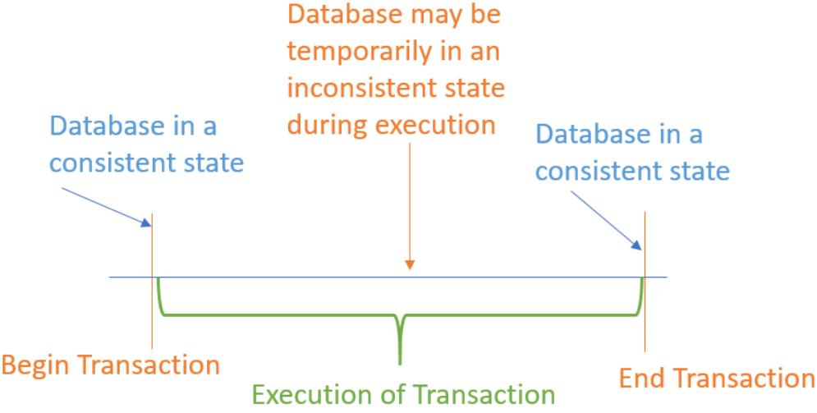
ACID properties of transaction
4. Durability
After a transaction completes successfully, the changes it has made to the database persist (permanent), even if there are system failures.
Once our transaction completed up to last step (step 6) its result must be stored permanently. It should not be removed if system fails.
A=500, B=500
read (A)
A = A – 50
write (A)
read (B)
B = B + 50
write (B)
A=450, B=550

Slide 12
Transaction State Diagram \ State Transition Diagram
When a transaction executes its final operation, it is said to be in a partially committed state.
The transaction enters in this state after successful completion of the transaction.
We cannot abort or rollback a committed transaction.
read (A)
A = A – 50
write (A)
read (B)
B = B + 50
write (B)
Commit
Partial
Committed
Committed
Active
End
Failed
Aborted
This is the initial state.
The transaction stays in this state while it is executing.
Discover that normal execution can no longer proceed.
Once a transaction cannot be completed, any changes that it made must be undone rolling it back.
The state after the transaction has been rolled back and the database has been restored to its state prior to the start of the transaction.

Slide 13
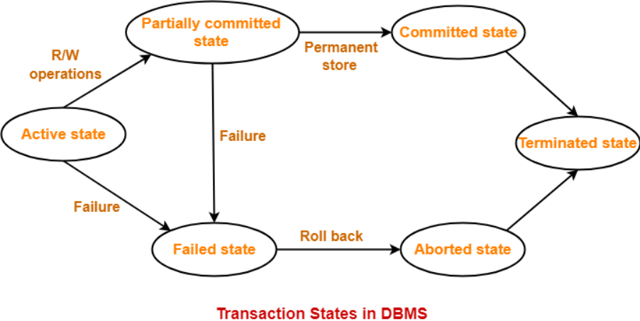
Transaction State Diagram \ State Transition Diagram
1. Active
This is the initial state.
The transaction stays in this state while it is executing.
2. Partial Committed
When a transaction executes its final operation/ instruction, it is said to be in a partially committed state.

Slide 14
Transaction State Diagram \ State Transition Diagram
3. Failed
Discover that normal execution can no longer proceed.
Once a transaction cannot be completed, any changes that it made must be undone rolling it back.
4. Aborted
The state after the transaction has been rolled back and the database has been restored to its state prior to the start of the transaction.
After aborting the transaction, the database recovery module will select one of the two operations:
Re-start the transaction
Kill the transaction

Slide 15
Transaction State Diagram \ State Transition Diagram
6. Terminated State-
After entering the committed state or aborted state, the transaction finally enters into a terminated state where its life cycle finally comes to an end.
5. Committed
A transaction is said to be in a committed state if it has executed all of its operations successfully. In this state, all the effects are now permanently saved on the database system.
In this state transactions may release all of its acquired resources.
After a transaction has entered the committed state, it is not possible to roll back the transaction.
In other words, it is not possible to undo the changes that has been made by the transaction.
This is because the system is updated into a new consistent state.
The only way to undo the changes is by carrying out another transaction called as compensating transaction that performs the reverse operations.

Slide 16
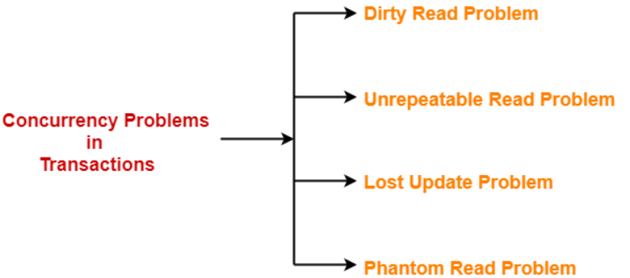
Concurrency Problems in DBMS-
When multiple transactions execute concurrently in an uncontrolled or unrestricted manner, then it might lead to several problems.
Such problems are called as concurrency problems.

Slide 17
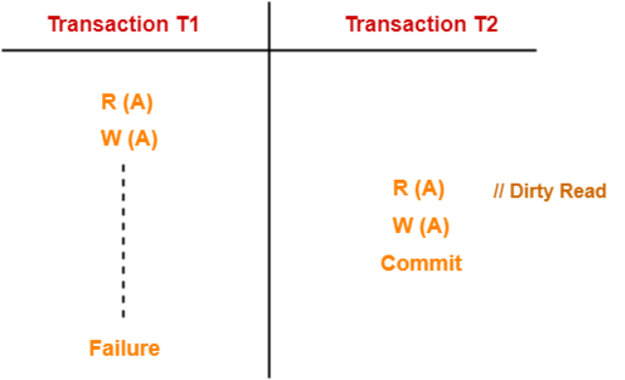
1. Dirty Read Problem-
Reading the data written by an uncommitted transaction is called as dirty read
This read is called as dirty read because-
There is always a chance that the uncommitted transaction might roll back later.
Thus, uncommitted transaction might make other transactions read a value that does not even exist.
This leads to inconsistency of the database.
NOTE-
Dirty read does not lead to inconsistency always.
It becomes problematic only when the uncommitted transaction fails and roll backs later due to some reason.
Here,
T1 reads the value of A.
T1 updates the value of A in the buffer.
T2 reads the value of A from the buffer.
T2 writes the updated the value of A.
T2 commits.
T1 fails in later stages and rolls back.
T2 reads the dirty value of A written by the uncommitted transaction T1.
T1 fails in later stages and roll backs.
Thus, the value that T2 read now stands to be incorrect.
Therefore, database becomes inconsistent.

Slide 18
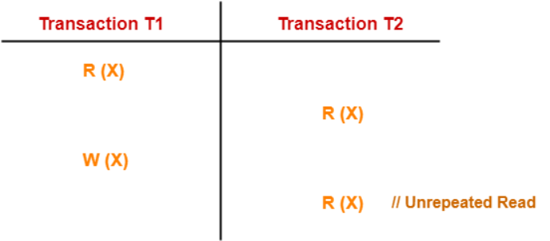
2. Unrepeatable Read Problem-
This problem occurs when a transaction gets to read unrepeated i.e. different values of the same variable in its different read operations even when it has not updated its value.
Here,
T1 reads the value of X (= 10 say).
T2 reads the value of X (= 10).
T1 updates the value of X (from 10 to 15 say) in the buffer.
T2 again reads the value of X (but = 15).
*For T2 there is a violation of Isolation
In this example,
T2 gets to read a different value of X in its second reading.
T2 wonders how the value of X got changed because according to it, it is running in isolation.

Slide 19
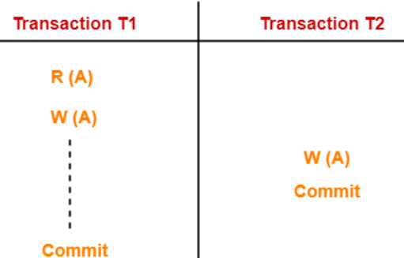
3. Lost Update Problem-
This problem occurs when multiple transactions execute concurrently and updates from one or more transactions get lost.
In this example,
T1 writes the over written value of X in the database.
Thus, update from T1 gets lost.
NOTE-
This problem occurs whenever there is a write-write conflict.
In write-write conflict, there are two writes one by each transaction on the same data item without any read in the middle.
Here,
T1 reads the value of A (= 10 say).
T2 updates the value to A (= 15 say) in the buffer.
T2 does blind write A = 25 (write without read) in the buffer.
T2 commits.
When T1 commits, it writes A = 25 in the database.

Slide 20
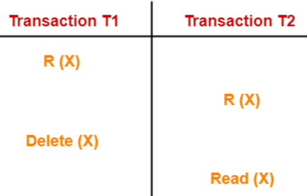
4. Phantom Read Problem-
This problem occurs when a transaction reads some variable from the buffer and when it reads the same variable later, it finds that the variable does not exist
In this example,
T2 finds that there does not exist any variable X when it tries reading X again.
T2 wonders who deleted the variable X because according to it, it is running in isolation
Avoiding Concurrency Problems-
To ensure consistency of the database, it is very important to prevent the occurrence of above problems.
Concurrency Control Protocols help to prevent the occurrence of above problems and maintain the consistency of the database.
Here,
T1 reads X.
T2 reads X.
T1 deletes X. from the schema
T2 tries reading X but does not find it.
So we need concurrency protocols to deal with these different problems

Slide 21
What is schedule?
A schedule is a process of grouping the transactions into one and executing them in a predefined order.
A schedule is the chronological (sequential) order in which instructions are executed in a system.
A schedule is required in a database because when some transactions execute in parallel, they may affect the result of the transaction.
Means if one transaction is updating the values which the other transaction is accessing, then the order of these two transactions will change the result of another transaction.
Hence a schedule is created to execute the transactions.

Slide 22
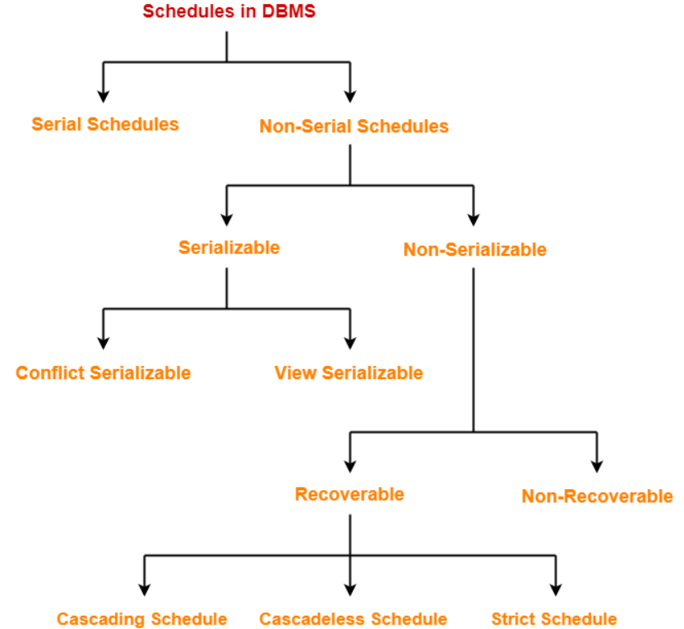
The order in which the operations of multiple transactions appear for execution is called as a schedule

Slide 23
Example of schedule
T1 | T2
Read (A) A = A - 50 Write (A) Read (B) B = B + 50 Write (B) Commit
 | Read (A) temp = A * 0.1 A = A - temp Write (A) Read (B) B = B + temp Write (B) Commit
A=B=1000
Read (1000) A = 1000 - 50 Write (950) Read (1000) B = 1000 + 50 Write (1050) Commit
Read (950) temp = 950 * 0.1 A = 950 - 95 Write (855) Read (1050) B = 1050 + 95 Write (1145) Commit

Slide 24
Example of schedule
T1 | T2
Read (A) Temp = A * 0.1 A = A - temp Write (A) Read (B) B = B + temp Write (B) Commit
 | Read (A) A = A - 50 Write (A) Read (B) B = B + 50 Write (B) Commit
A=B=1000
Read (1000) Temp = 1000 * 0.1 A = 1000 - 100 Write (900) Read (1000) B = 1000 + 100 Write (1100) Commit
Read (900) A = 900 - 50 Write (850) Read (1100) B = 1100 + 50 Write (1150) Commit

Slide 25
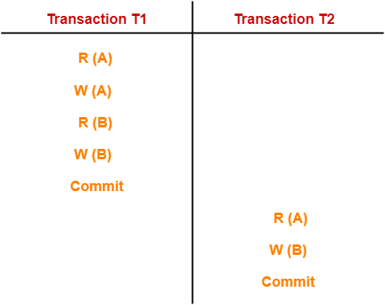
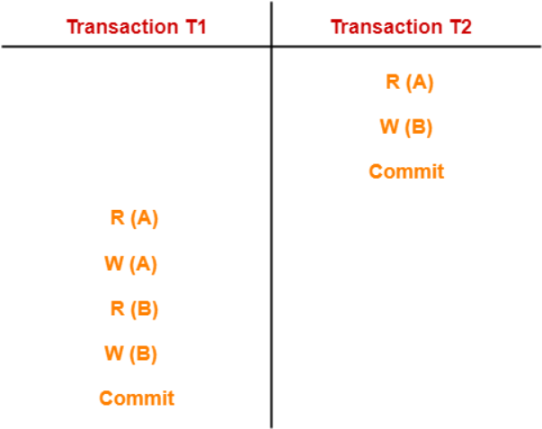
Serial Schedules-
In serial schedules,
All the transactions execute serially one after the other.
When one transaction executes, no other transaction is allowed to execute.
Characteristics- Serial schedules are always-
Consistent
Recoverable
Cascadeless
Strict
Serial Schedules
T1,T2
T2,T1
Cascadelsss : allows only committed read operations

Slide 26
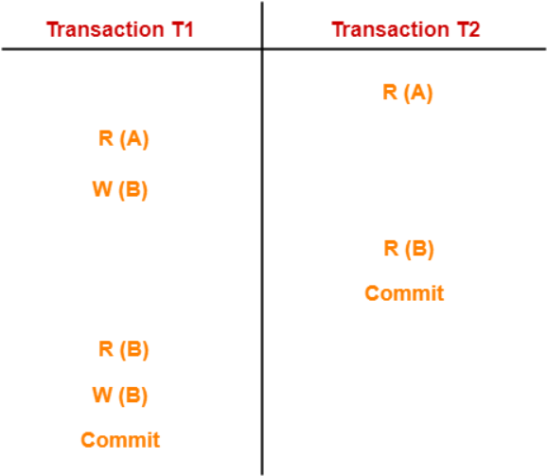
Non-Serial Schedules-
In non-serial schedules,
Multiple transactions execute concurrently.
Operations of all the transactions are inter leaved or mixed with each other.
Characteristics-
Non-serial schedules are NOT always-
Consistent
Recoverable
Cascadeless
Strict

Slide 27
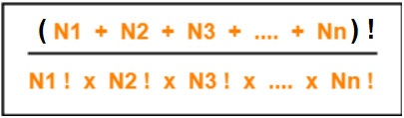
Finding Number Of Schedules-
Consider there are n number of transactions T1, T2, T3 …. , Tn with N1, N2, N3 …. , Nn number of operations respectively.
Total Number of Schedules-
Total number of possible schedules (serial + non-serial) is given by-
Total Number of Serial Schedules-
Total number of serial schedules
= Number of different ways of arranging n transactions
= n!
Total Number of Non-Serial Schedules-
Total number of non-serial schedules
= Total number of schedules – Total number of serial schedules

Slide 28
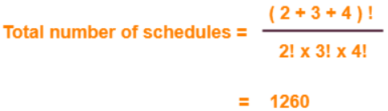
Problem-
Consider there are three transactions with 2, 3, 4 operations respectively, find-
How many total number of schedules are possible?
How many total number of serial schedules are possible?
How many total number of non-serial schedules are possible?
Solution-
Total Number of Schedules-
Using the above formula, we have-
Total Number of Serial Schedules-
Total number of serial schedules
= Number of different ways of arranging 3 transactions
= 3!
= 6
Total Number of Non-Serial Schedules-
Total number of non-serial schedules
= Total number of schedules – Total number of serial schedules
= 1260 – 6
= 1254

Slide 29
Serial Schedules | Serializable Schedules
No concurrency is allowed. Thus, all the transactions necessarily execute serially one after the other. | Concurrency is allowed. Thus, multiple transactions can execute concurrently.
Serial schedules lead to less resource utilization and CPU throughput. | Serializable schedules improve both resource utilization and CPU throughput.
Serial Schedules are less efficient as compared to serializable schedules. (due to above reason) | Serializable Schedules are always better than serial schedules. (due to above reason)

Slide 30
Serializability in DBMS-
Some non-serial schedules may lead to inconsistency of the database.
Serializability is a concept that helps to identify which non-serial schedules are correct and will maintain the consistency of the database.
Serializable Schedules-
If a given non-serial schedule of ‘n’ transactions is equivalent to some serial schedule of ‘n’ transactions, then it is called as a serializable schedule.
Characteristics-
Serializable schedules behave exactly same as serial schedules.
Thus, serializable schedules are always-
Consistent
Recoverable
Casacadeless
Strict

Slide 31
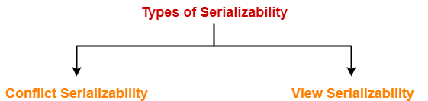
Types of Serializability-
Serializability is mainly of two types-
Serializability is a concept that helps to identify which non-serial schedules are correct and will maintain the consistency of the database.

Slide 32
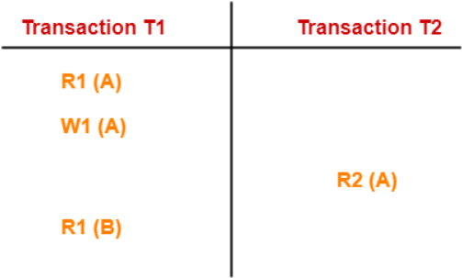
1. Conflict Serializability-
If a given non-serial schedule can be converted into a serial schedule by swapping its non-conflicting operations, then it is called as a conflict serializable schedule.
Conflicting Operations-
Two operations are called as conflicting operations if all the following conditions hold true for them-
Both the operations belong to different transactions
Both the operations are on the same data item
At least one of the two operations is a write operation
R1(X) W2(X)
W1(X) R2(X)
W1(X) W2(X)
In this schedule,
W1 (A) and R2 (A) are called as conflicting operations.
This is because all the above conditions hold true for them.

Slide 33
Checking Whether a Schedule is Conflict Serializable Or Not-
For schedule S, we construct a graph known as precedence graph. This graph has a pair G = (V, E), where V consists a set of vertices, and E consists a set of edges. The set of vertices is used to contain all the transactions participating in the schedule. The set of edges is used to contain all edges Ti ->Tj for which one of the three conditions holds:
Create a node Ti → Tj if Ti executes write (Q) before Tj executes read (Q).
Create a node Ti → Tj if Ti executes read (Q) before Tj executes write (Q).
Create a node Ti → Tj if Ti executes write (Q) before Tj executes write (Q).
*create an edge on conflicting operation of different transactions on same data item
Step-01: Find and list all the conflicting operations.
Step-02: Start creating a precedence graph by drawing one node for each transaction.
Step-03: Draw an edge for each conflict pair such that if T_{i} (Q) and T_{j} (Q) forms a conflict pair then draw an edge from T_{i} to T_{j}. This ensures that T_{i} gets executed before T_{j}.
Step-04: Check if there is any cycle formed in the graph.
If there is no cycle found, then the schedule is conflict serializable otherwise not.
NOTE: By performing the Topological Sort of the Directed Acyclic Graph so obtained, the corresponding serial schedule(s) can be found. Such schedules can be more than 1.

Slide 34
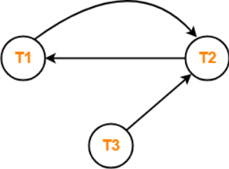
PRACTICE PROBLEMS BASED ON CONFLICT SERIALIZABILITY-
Problem-01: Check whether the given schedule S is conflict serializable or not-
S : R₁(A) , R₂(A) , R₁(B) , R₂(B) , R₃(B) , W₁(A) , W₂(B)
Solution-
Step-01: List all the conflicting operations and determine the dependency between the transactions-
R₂(A) , W₁(A) (T₂ → T₁)
R₁(B) , W₂(B) (T₁ → T₂)
R₃(B) , W₂(B) (T₃ → T₂)
Step-02: Draw the precedence graph-
Clearly, there exists a cycle in the precedence graph.
Therefore, the given schedule S is not conflict serializable.

Slide 35
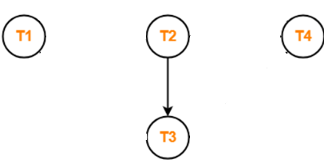
Problem-02: Check whether the given schedule S(with commit) is conflict serializable and recoverable or not-
T1 | T2 | T3 | T4
 | R(X)
 |  | W(X)
 |  | commit
W(X)
commit
 | W(Y)
 | R(Z)
 | commit
 |  |  | R(X)
 |  |  | R(Y)
 |  |  | commit
Step-01: List all the conflicting operations and determine the
dependency between the transactions-
R₂(X) , W₃(X) (T₂ → T₃)
Step-02: Draw the precedence graph-
Clearly, there exists no cycle in the precedence graph.
Therefore, the given schedule S is conflict serializable.

Slide 36
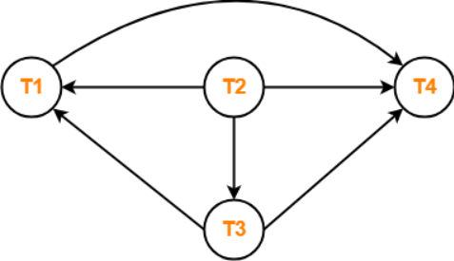
Problem-03: Check whether the given schedule S is conflict serializable and recoverable or not-
Step-01: List all the conflicting operations and determine the dependency between
the transactions-
R₂(X) , W₃(X) (T₂ → T₃)
R₂(X) , W₁(X) (T₂ → T₁)
W₃(X) , W₁(X) (T₃ → T₁)
W₃(X) , R₄(X) (T₃ → T₄)
W₁(X) , R₄(X) (T₁ → T₄)
W₂(Y) , R₄(Y) (T₂ → T₄)
Step-02: Draw the precedence graph-
T1 | T2 | T3 | T4
 | R(X)
 |  | W(X)
W(X)
 | W(Y)
 | R(Z)
 |  |  | R(X)
 |  |  | R(Y)
Clearly, there exists no cycle in the precedence graph.
Therefore, the given schedule S is conflict serializable.

Slide 37
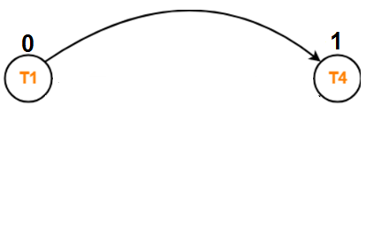
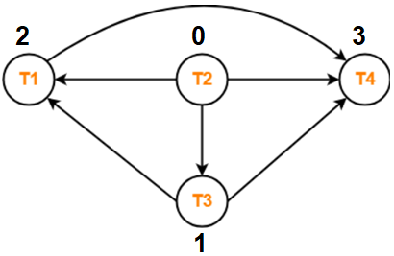
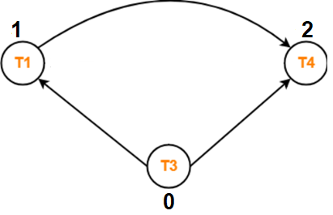
Problem-03: Check whether the given schedule S is conflict serializable and recoverable or not-
T1 | T2 | T3 | T4
 | R(X)
 |  | W(X)
W(X)
 | W(Y)
 | R(Z)
 |  |  | R(X)
 |  |  | R(Y)
The topological orderings is used in the Topological Sort, to know the order of serialization.
T2 →
T3 →
T1 →
T4

Slide 38
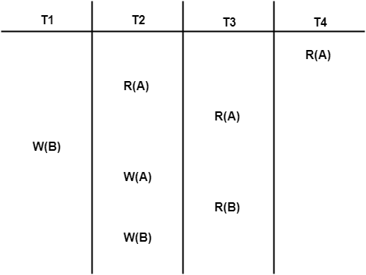
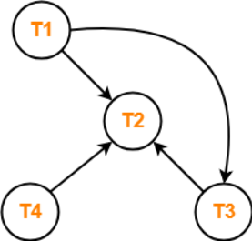
Problem-04: Check whether the given schedule S is conflict serializable or not. If yes, then determine all the possible serialized schedules-
Step-01: List all the conflicting operations and determine the dependency between the transactions-
R₄(A) , W₂(A) (T₄ → T₂)
R₃(A) , W₂(A) (T₃ → T₂)
W₁(B) , R₃(B) (T₁ → T₃)
W₁(B) , W₂(B) (T₁ → T₂)
R₃(B) , W₂(B) (T₃ → T₂)
Step-02: Draw the precedence graph-
Clearly, there exists no cycle in the precedence graph.
Therefore, the given schedule S is conflict serializable.
After performing the topological sort, the possible serialized schedules are-
T₁ → T₃ → T₄ → T₂
T₁ → T₄ → T₃ → T₂
T₄ → T₁ → T₃ → T₂

Slide 39
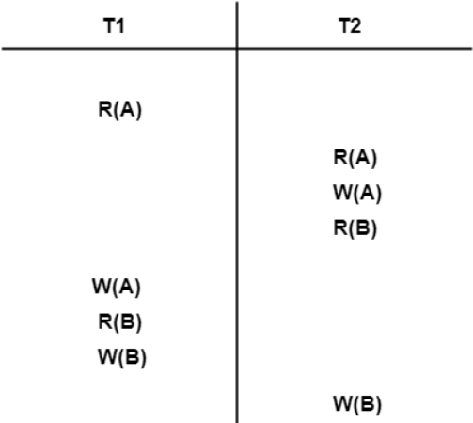
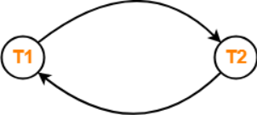
Problem-05: Determine all the possible serialized schedules for the given schedule-
Step-01:
List all the conflicting operations and determine the dependency between the transactions-
R₁(A) , W₂(A) (T₁ → T₂)
R₂(A) , W₁(A) (T₂ → T₁)
W₂(A) , W₁(A) (T₂ → T₁)
R₂(B) , W₁(B) (T₂ → T₁)
R₁(B) , W₂(B) (T₁ → T₂)
W₁(B) , W₂(B) (T₁ → T₂)
Step-02:
Draw the precedence graph-
Clearly, there exists a cycle in the precedence graph.
Therefore, the given schedule S is not conflict serializable.
Thus, Number of possible serialized schedules = 0.

Slide 40
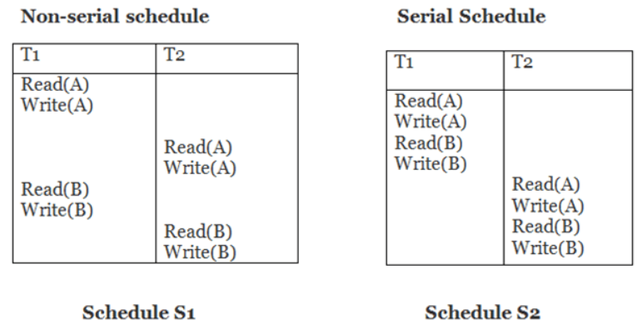
Conflict Equivalent
In the conflict equivalent, one can be transformed to another by swapping non-conflicting operations. In the given example, S2 is conflict equivalent to S1 (S1 can be converted to S2 by swapping non-conflicting operations).
Two schedules are said to be conflict equivalent if and only if:
They contain the same set of the transaction.
If each pair of conflict operations are ordered in the same way.
Example:
Schedule S2 is a serial schedule because, in this, all operations of T1 are performed before starting any operation of T2.
Schedule S1 can be transformed into a serial schedule by swapping non-conflicting operations of S1.
So, S1 is conflict serializable.
S1=S2

Slide 41
Inconsistent
Consistent
Conflict serializability is easy to achieve but view serializability is hard to achieve
View S.
Every conflict serializable is view serializable but the reverse is not true.
Conflict S.
It is much easy to test conflict serializability but expensive to test view serializability.
Most of the concurrency control schemes used in practice are based on conflict serializability.

Slide 42
2. View Serializability-
View Equivalent Schedules-
Consider two schedules S1 and S2 each consisting of two transactions T1 and T2.
Schedules S1 and S2 are called view equivalent if the following three conditions hold true for them-
Condition-01: For each data item X, if transaction T_{i} reads X from the database initially in schedule S1, then in schedule S2 also, T_{i} must perform the initial read of X from the database.
Condition-02: If transaction Ti reads a data item that has been updated by the transaction Tj in schedule S1, then in schedule S2 also, transaction Ti must read the same data item that has been updated by the transaction Tj.
Condition-03: For each data item X, if X has been updated at last by transaction T_{i} in schedule S1, then in schedule S2 also, X must be updated at last by transaction T_{i}
If a given schedule is found to be view equivalent to some serial schedule, then it is called as a view serializable schedule.
Initial readers must be same for all the data items
Write-read sequence must be same.
Final writers must be same for all the data items

Slide 43
Problem-01: Check whether the given schedule S1 is view serializable or not-
S1
S2
S3
T1 | T2
R(A)
W(A)
 | R(A)
 | W(A)
R(B)
W(B)
 | R(B)
 | W(B)
T1 | T2
R(A)
W(A)
R(B)
W(B)
 | R(A)
 | W(A)
 | R(B)
 | W(B)
T1 | T2
 | R(A)
 | W(A)
 | R(B)
 | W(B)
R(A)
W(A)
R(B)
W(B)
Initial readers must be same for all the data items
Write-read sequence must be same.
Final writers must be same for all the data items
Schedule is view serializable.
T1(A), T1(B)
T1->T2(A),T1->T2(B)
T2(A), T2(B)
T1(A), T1(B)
T1->T2(A),T1->T2(B)
T2(A), T2(B)
T2(A), T2(B)
T2->T1(A),T2->T1(B)
T1(A), T1(B)

Slide 44
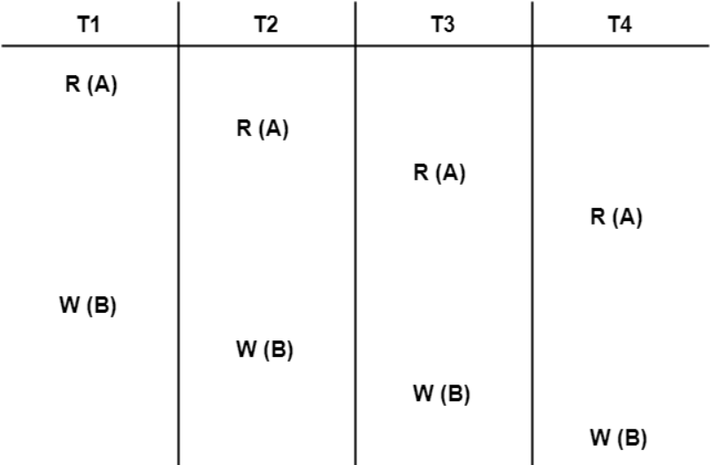
Problem-02: Check whether the given schedule S is view serializable or not-
Initial readers must be same for all the data items
Write-read sequence must be same.
Final writers must be same for all the data items
Schedule is view serializable.
So we consider a serial schedule S’=T1, T2, T3, T4
T1(A)
There is no write read sequence
T4(B)
T1(A)
There is no write read sequence
T4(B)

Slide 45
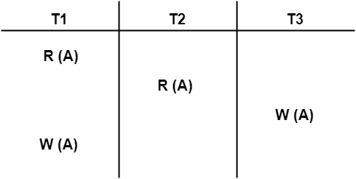
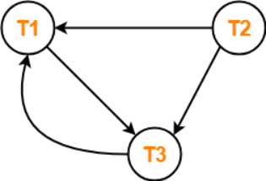
Problem-03: Check whether the given schedule S is view serializable or not-
T1 firstly reads A and T3 firstly updates A.
So, T1 must execute First.
Final updation on A is made by the transaction T1.
So, T1 must execute after all other transactions.
Thus, we get the dependency (T2, T3) → T1.
There exists no write-read sequence.
T1(A)
No producer consumer
T1(A)
Thus, we conclude that the given schedule S is not view serializable.
Also not a conflict serializable

Slide 46
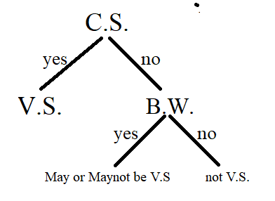
Checking Whether a Schedule is View Serializable Or Not-
Method-01: If the given schedule is conflict serializable, then it is surely view serializable.
Thumb Rules
All conflict serializable schedules are view serializable.
All view serializable schedules may or may not be conflict serializable.
Method-02: Check if there exists any blind write operation. (Writing without reading is called as a blind write).
If there does not exist any blind write, then the schedule is surely not view serializable.
If there exists any blind write, then the schedule may or may not be view serializable. Go and check using other methods.
Method-03: In this method, try finding a view equivalent serial schedule.
By using the defined three conditions.

Slide 47
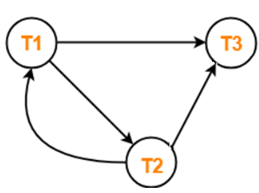
Problem-03: Check whether the given schedule S is view serializable or not
T1 | T2 | T3
R(A)
 | W(A)
W(A)
 |  | W(A)
First we will check conflict serializability
R1(A) W2(A)
R1(A) W3(A)
W2(A) W3(A)
W2(A) W1(A)
W1(A) W3(A)
T1(A)
No producer consumer
T3(A)
Consider a serial schedule S’=T1 T2 T3
Not Conflict serializable
T1(A)
No producer consumer
T3(A)
Is a view serializable

Slide 48
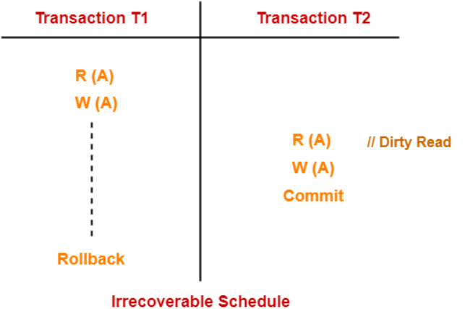
Irrecoverable Schedules-
If in a schedule,
A transaction performs a dirty read operation from an uncommitted transaction
And commits before the transaction from which it has read the value
then such a schedule is known as an Irrecoverable Schedule.
Example-
Consider the following schedule-
Here
T2 performs a dirty read operation.
T2 commits before T1.
T1 fails later and roll backs.
The value that T2 read now stands to be incorrect.
T2 can not recover since it has already committed.

Slide 49
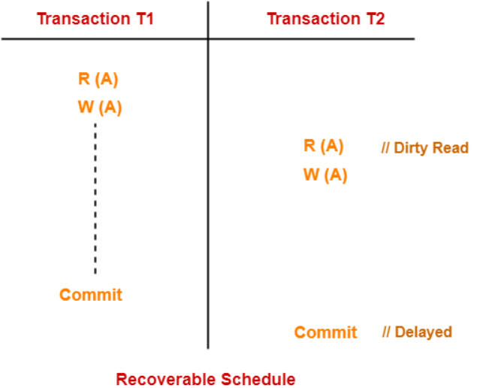
Recoverable Schedules-
If in a schedule,
A transaction performs a dirty read operation from an uncommitted transaction
And its commit operation is delayed till the uncommitted transaction either commits or roll backs then such a schedule is known as a Recoverable Schedule.
Here,
The commit operation of the transaction that performs the dirty read is delayed.
This ensures that it still has a chance to recover if the uncommitted transaction fails later.
Example- Consider the following schedule-
Here,
T2 performs a dirty read operation.
The commit operation of T2 is delayed till T1 commits or roll backs.
T1 commits later.
T2 is now allowed to commit.
In case, T1 would have failed, T2 has a chance to recover by rolling back.

Slide 50
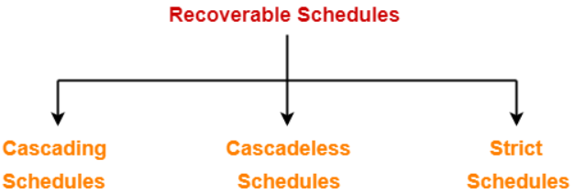
Types of Recoverable Schedules-
A recoverable schedule may be any one of these kinds-
Cascading Schedule
Cascadeless Schedule
Strict Schedule

Slide 51
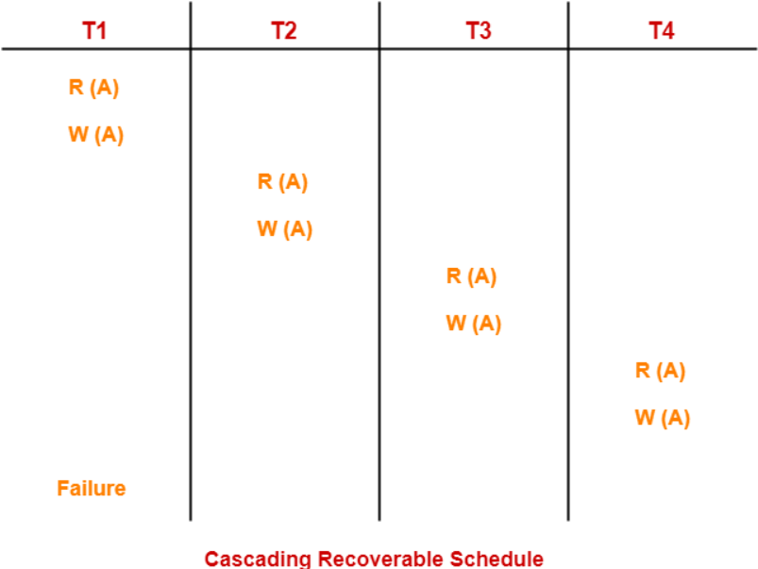
a. Cascading Schedule-
If in a schedule, failure of one transaction causes several other dependent transactions to rollback or abort, then such a schedule is called as a Cascading Schedule or Cascading Rollback or Cascading Abort.
It simply leads to the wastage of CPU time.
Here,
Transaction T2 depends on transaction T1.
Transaction T3 depends on transaction T2.
Transaction T4 depends on transaction T3.
In this schedule,
The failure of transaction T1 causes the transaction T2 to rollback.
The rollback of transaction T2 causes the transaction T3 to rollback.
The rollback of transaction T3 causes the transaction T4 to rollback.
Such a rollback is called as a Cascading Rollback
If the transactions T2, T3 and T4 would have committed before the failure of transaction T1, then the schedule would have been irrecoverable.

Slide 52
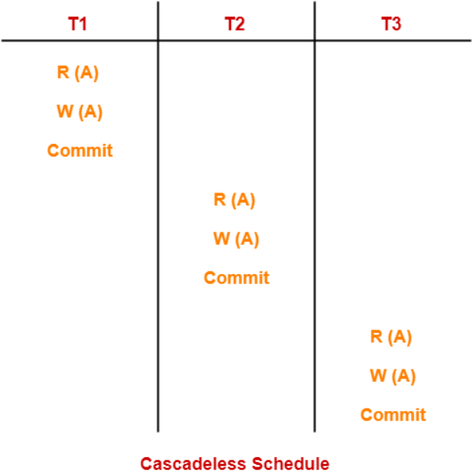
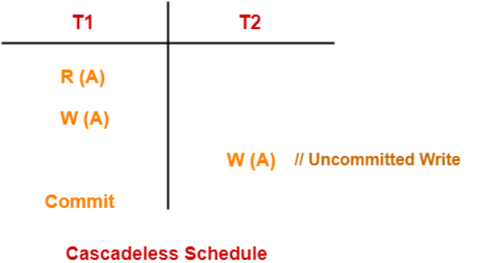
b. Cascadeless Schedule-
If in a schedule, a transaction is not allowed to read a data item until the last transaction that has written it is committed or aborted, then such a schedule is called as a Cascadeless Schedule.
In other words,
Cascadeless schedule allows only committed read operations.
Therefore, it avoids cascading roll back and thus saves CPU time
NOTE-
Cascadeless schedule allows only committed read operations.
However, it allows uncommitted write operations.

Slide 53
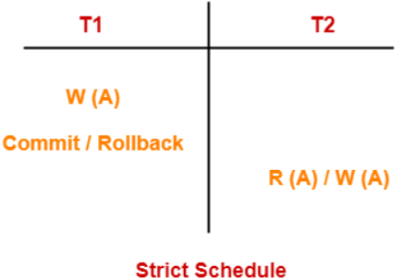
c. Strict Schedule-
If in a schedule, a transaction is neither allowed to read nor write a data item until the last transaction that has written it is committed or aborted, then such a schedule is called as a Strict Schedule.
In other words,
Strict schedule allows only committed read and write operations.
Clearly, strict schedule implements more restrictions than cascadeless schedule.

Slide 54
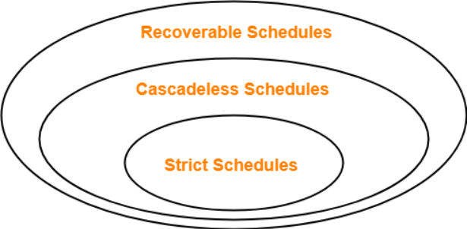
Remember-
Strict schedules are more strict than cascadeless schedules.
All strict schedules are cascadeless schedules.
All cascadeless schedules are not strict schedules.

Slide 55
Concurrency Control
In the concurrent schedule, the multiple transactions can be executed simultaneously.
It may affect the transaction result. It is highly important to maintain the order of execution of those transactions.
Problems of concurrency control
Several problems can occur when concurrent transactions are executed in an uncontrolled manner. Following are the three problems in concurrency control.
Lost updates
Dirty read
Unrepeatable read
Phantom read
Concurrency Control Protocol
Concurrency control protocols ensure atomicity, isolation, and serializability of concurrent transactions. The concurrency control protocol can be divided into three categories:
Lock based protocol
Time-stamp protocol
Validation based protocol

Slide 56
1. Lock-Based Protocol
In this type of protocol, any transaction cannot read or write data until it acquires an appropriate lock on it. There are two types of lock:
1. Shared lock:
It is also known as a Read-only lock. In a shared lock, the data item can only read by the transaction.
It can be shared between the transactions because when the transaction holds a lock, then it can't update the data on the data item.
2. Exclusive lock:
In the exclusive lock, the data item can be both reads as well as written by the transaction.
This lock is exclusive, and in this lock, multiple transactions do not modify the same data simultaneously.
There are four types of lock protocols available:
Basic 2 PL (Basic two phase locking protocol)
Conservative 2 PL
Strict 2 PL
Rigorous 2 PL

Slide 57
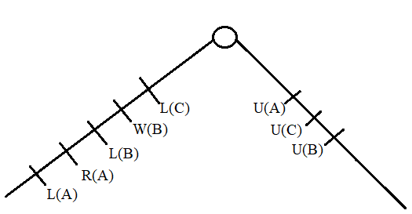
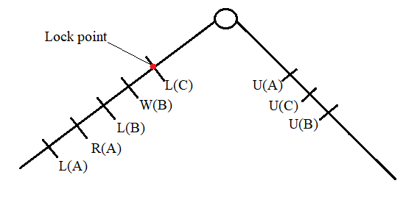
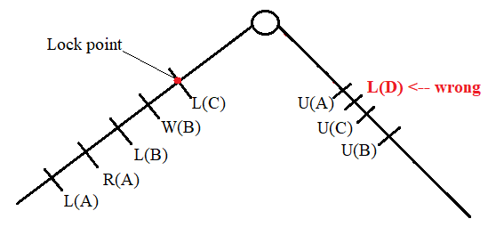
A. Basic 2 PL
Phase 1: Growing Phase
Transaction may obtain locks
Transaction may not release locks
Phase 2: Shrinking Phase
Transaction may release locks
Transaction may not obtain locks
A transaction may be granted a lock on an item if the requested lock is compatible with locks already held on the item by other transactions.
Any number of transactions can hold shared locks on an item, but if any transaction holds an exclusive(X) on the item no other transaction may hold any lock on the item.
If a lock cannot be granted, the requesting transaction is made to wait till all incompatible locks held by other transactions have been released. Then the lock is granted.

Slide 58
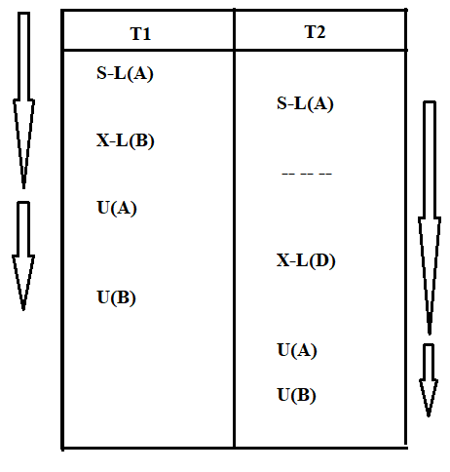
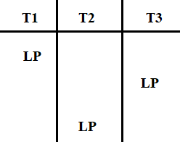
Upgrade / Downgrade locks : A transaction that holds a lock on an item A is allowed under certain condition to change the lock state from one state to another.
Upgrade: A Lock-S(A) can be upgraded to Lock-X(A) if T_{i} is the only transaction holding the S-lock on element A. Downgrade: We may downgrade Lock-X(A) to Lock-S(A) when we feel that we no longer want to write on data-item A. As we were holding X-lock on A, we don’t need to check any conditions.
The lock point ensure the serializability order:
T1→T3→T2
Advantage:
Schedule which follows 2PL is a serializable.

Slide 59
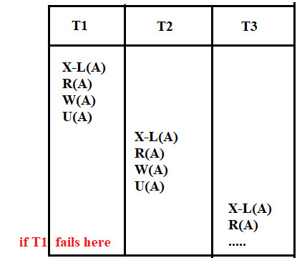
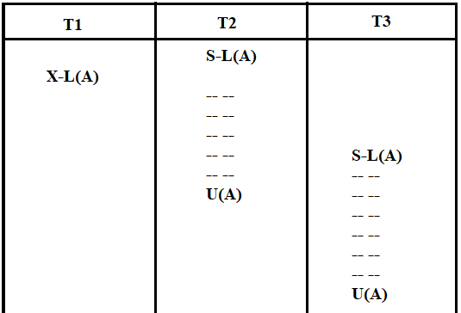
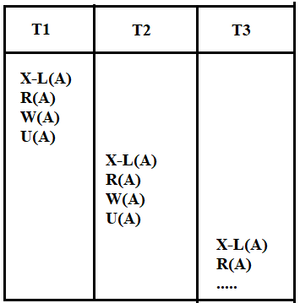
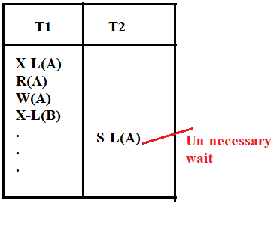
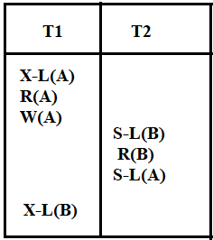

5
3
Problems in Basic 2 PL:
Resource utilization is low
Not free from Deadlock
Not free from Cascading rollback
Can not guarantee recoverable schedule
Not free from starvation
1
2
4

Slide 60


B. Conservative 2 PL (Selfish in nature)
It should satisfy the basic 2PL.
Before transaction starts, Lock all the data item that your transaction need.
No Deadlock
Practical implementation is difficult(early prediction)
Suffering from Cascading rollback (no commit is defined)

Slide 61



C. Strict 2 PL
It should satisfy the basic 2PL.
Transaction T does not releases any of exclusive lock until it commit or abort.
No cascading rollback
Can have dead lock
cascadless
Recoverability is easy(Strict)
Guarantees strict schedule

Slide 62


D. Rigorous 2 PL
It should satisfy the basic 2PL.
A transaction T does not releases any of its lock until it commit or abort.
There is a chances of dead lock

Slide 63
R
Basic 2PL
S2PL
R2PL

Slide 64

2. Timestamp Ordering Protocol
The Timestamp Ordering Protocol is used to order the transactions based on their Timestamps. The order of transaction is nothing but the ascending order of the transaction creation.
The priority of the older transaction is higher that's why it executes first. To determine the timestamp of the transaction, this protocol uses system time or logical counter.
A unique value is assigned to every transaction.
Tells the order(when they entered into the system)
Read_TS(X): last(latest) successful read operation performed by transaction no.
Write_TS(X): last(latest) successful write operation performed by transaction no.
Let's assume there are two transactions T1 , T2and T3. Suppose the transaction T1 has entered the system at 10:00 AM times and transaction T2 has entered the system at 10:05 AM times transaction T3 has entered the system at 10:10 AM times. T1 has the higher priority,
time stamp T1=10 => TS(T1)=10
time stamp T2=20 (or any value which is greater than 100)
time stamp T3=30 => TS(T3)=30
T1 is older and T3 is youngest transaction.
RTS(A):30
WTS(A):20
These values will changed as schedule progress.

Slide 65










Basic Timestamp ordering protocol works as follows (assumption: the older transaction finishes first)
1. Check the following condition whenever a transaction Ti issues a Read (X) operation:
If W_TS(X) >TS(Ti) then , rollback Ti.
Otherwise Read(X) operation is executed.
Set R_TS(X)=Max{R_TS(X), TS(Ti)}
2. Check the following condition whenever a transaction Ti issues a Write(X) operation:
If R_TS(X) > TS(Ti) then , rollback Ti.
If W_TS(X) > TS(Ti) then ,rollback Ti.
otherwise the Write(X) operation is executed.
Set W_TS(X)=TS(Ti)
So whenever a younger transaction read(x) first, then older transaction will only perform read(x) after it, in all other cases older transaction has to rollback.

Slide 66









Problem: In a given Schedule which transaction roll backed, on applying time stamp ordering.
0>100
0>200
0>100
0>100
0>300
100>100
300>200
100>300
0>300
1. Check the following condition whenever a transaction Ti issues a Read (X) operation:
If W_TS(X) >TS(Ti) then , rollback Ti.
Otherwise Read(X) operation is executed.
Set R_TS(X)=Max{R_TS(X), TS(Ti)}
2. Check the following condition whenever a transaction Ti issues a Write(X) operation:
If R_TS(X) > TS(Ti) then , rollback Ti.
If W_TS(X) > TS(Ti) then ,rollback Ti.
otherwise the Write(X) operation is executed.
Set W_TS(X)=TS(Ti)

Slide 67

Advantages and Disadvantages of TO protocol:
TO protocol ensures serializability since the precedence graph is as follows:
TS protocol ensures freedom from deadlock that means no transaction ever waits.
But the schedule may not be recoverable and may not even be cascade- free.

Slide 68
To maintain consistency in concurrent schedule we have to pay extra cost for concurrency control(in terms of programming) while executing the set of transactions, due to which our transaction delayed sometime, so is there any way to reduce this overhead, a monitoring system is used:
3. Validation Based Protocol
Validation phase is also known as optimistic concurrency control technique. In the validation based protocol, the transaction is executed in the following three phases:
Read phase: In this phase, the transaction T execute read and write operation. i.e. read the value of various data items and stores them in temporary local variables. Transaction perform all the write operations on temporary variables without an update to the actual database.
Validation phase: In this phase, the temporary variable value will be validated against the actual data to see if it violates the serializability.
Write phase: If the validation of the transaction is validated, then the temporary results are written to the database or system otherwise the transaction is rolled back.

Slide 69
To perform validation test, we need to know when the various phases of transaction Ti took place, therefore here each phase has the following different timestamps:
Start(Ti): It contains the time when Ti started its execution.
Validation (T_{i}): It contains the time when Ti finishes its read phase and starts its validation phase.
Finish(Ti): It contains the time when Ti finishes its write phase.
This protocol is used to determine the time stamp for the transaction for serialization using the time stamp of the validation phase, as it is the actual phase which determines if the transaction will commit or rollback.
Hence TS(T) = validation(T).
The serializability is determined during the validation process. It can't be decided in advance.
If TS(Ti)<TS(Tj), whatever schedule we have then that must be equal to serial schedule Ti→Tj.
While executing the transaction, it ensures a greater degree of concurrency and also less number of conflicts.
Thus it contains transactions which have less number of rollbacks.

Slide 70

Validation test : The validation test for transaction Tj requires that for all transaction Ti with TS(Ti)<TS(Tj) one of the following condition hold.
Finish(Ti) < Start(Tj), since Ti finished before Tj started hence serializability order is indeed maintained.
Start(Tj) < Finish (Ti) < Validation(Tj). The set of data item written by Ti does not intersect with read of Tj. i.e. Read_set(Tj) is disjoint with Written_set(Ti)
TS(Ti) < TS(Tj)
No cascading rollback
May occur starvation
No deadlock

Slide 71
Failure Classification
To find that where the problem has occurred, we generalize a failure into the following categories:
1. Transaction failure
The transaction failure occurs when it fails to execute or when it reaches a point from where it can't go any further. If a few transaction or process is hurt, then this is called as transaction failure.
Reasons for a transaction failure could be -
Logical errors: If a transaction cannot complete due to some code error or an internal error condition, then the logical error occurs.
Syntax error: It occurs where the DBMS itself terminates an active transaction because the database system is not able to execute it. For example, The system aborts an active transaction, in case of deadlock or resource unavailability.
2. System Crash
System failure can occur due to power failure or other hardware or software failure. Example: Operating system error.
Fail-stop assumption: In the system crash, non-volatile storage is assumed not to be corrupted.
3. Disk Failure
It occurs where hard-disk drives or storage drives used to fail frequently. It was a common problem in the early days of technology evolution.
Disk failure occurs due to the formation of bad sectors, disk head crash, and unreachability to the disk or any other failure, which destroy all or part of disk storage.

Slide 72
Database recovery
There are many situations in which a transaction may not reach a commit or abort point.
Operating system crash
DBMS crash
System might lose power (power failure)
Disk may fail or other hardware may fail (disk/hardware failure)
Human error
In any of above situations, data in the database may become inconsistent or lost.

Slide 73
Database recovery
For example, if a transaction has completed 30 out of 40 write instructions to the database when the DBMS crashes, then the database may be in an inconsistent state as only part of the transaction’s work was completed.
Database recovery is the process of restoring the database and the data to a consistent state.
This may include restoring lost data up to the point of the event (e.g. system crash).

Slide 74
Log based recovery method
The log is a sequence of log records, which maintains information about update activities on the database.
A log is kept on stable storage (i.e HDD).
Log contains
Start of transaction
Transaction-id
Record-id
Type of operation (insert, update, delete)
Old value, new value
End of transaction that is committed or aborted.

Slide 75
Log based recovery method
When transaction T_{i} starts, it registers itself by writing a record
<T_{i} start> to the log
Before T_{i} executes write(X), a log record <T_{i}, X, V1, V2> is written, where V1 is the value of X before the write (the old value), and V2 is the value to be written to X (the new value).
When T_{i} finishes it last statement, the log record <T_{i} commit> is written.
Undo of a log record <Ti, X, V1, V2> writes the old value V1 to X
Redo of a log record <Ti, X, V1, V2> writes the new value V2 to X
Types of log based recovery method
Immediate database modification
Deferred database modification

Slide 76
Immediate v/s Deferred database modification
Immediate database modification | Deferred database modification
Updates (changes) to the database are applied immediately as they occur without waiting to reach to the commit point. | Updates (changes) to the database are deferred (postponed) until the transaction commits.
A=500, B=600, C=700
T1 | T2
Read (A) A = A - 100 Write (A) Read (B) B = B + 100 Write (B) Commit
 | Read (C) C = C - 200 Write (C) Commit
A=500, B=600, C=700
<T1 start>
<T1, A, 500, 400>
<T1, B, 600, 700>
A=400,B=700,C=700
<T1 start>
<T1, A, 400>
<T1, B, 700>
A=500,B=600,C=700
<T1 start>
<T1, A, 500, 400>
<T1, B, 600, 700>
<T1, Commit>
<T2 start>
<T2, C, 700, 500>
<T2, Commit>
A=400,B=700,C=500
<T1 start>
<T1, A, 400>
<T1, B, 700>
<T1, Commit>
<T2 start>
<T2, C, 500>
<T2, Commit>
A=400,B=700,C=500
<T1 start>
<T1, A, 500, 400>
<T1, B, 600, 700>
<T1, Commit>
<T2 start>
<T2, C, 700, 500>
A=400,B=700,C=500
<T1 start>
<T1, A, 400>
<T1, B, 700>
<T1, Commit>
<T2 start>
<T2, C, 500>
A=400,B=700,C=700

Slide 77
Immediate v/s Deferred database modification
Immediate database modification | Deferred database modification
Updates (changes) to the database are applied immediately as they occur without waiting to reach to the commit point. | Updates (changes) to the database are deferred (postponed) until the transaction commits.
If transaction is not committed, then we need to do undo operation and restart the transaction again. | If transaction is not committed, then no need to do any undo operations. Just restart the transaction.
If transaction is committed, then no need to do redo the updates of the transaction. | If transaction is committed, then we need to do redo the updates of the transaction.
Undo and Redo both operations are performed. | Only Redo operation is performed.

Slide 78
Problems with Deferred & Immediate Updates
Searching the entire log is time consuming.
Immediate database modification
When transaction fail log file is used to undo the updates of transaction.
Deferred database modification
When transaction commits log file is used to redo the updates of transaction.
To reduce the searching time of entire log we can use check point.

Slide 79
Checkpoint
It is a point which specifies that any operations executed before it are done correctly and stored safely (updated safely in database).
At this point, all the buffers are force-fully written to the secondary storage (database).
Checkpoints are scheduled at predetermined time intervals.
It is used to limit:
Size of transaction log file
Amount of searching

Slide 80
Checkpoint works when failure occurs
At failure time:
Ignore the transaction T1 as it has already been committed before checkpoint.
Redo transaction T2 and T3 as they are active after checkpoint and are committed before failure.
Undo transaction T4 as it is active after checkpoint and has not committed.
Time
T_{C}
T_{f}
T1
T2
T3
T4
Checkpoint time
Failure

Slide 81
Page table structure
The database is partitioned into fixed-length blocks referred to as PAGES.
Page table has n entries – one for each database page.
Each entry contain pointer to a page on disk.
1
2
3
4
5
.
n
2
1
4
101
202
n
1
2
3
4
:
:
101
:
:
201
202
n
Page Table
Pages
Pages on disk

Slide 82
Shadow paging technique
Shadow paging is an alternative to log-based recovery.
This scheme is useful if transactions execute serially.
It maintain two page tables during the lifetime of a transaction
current page table
shadow page table
Shadow page table is stored on non-volatile storage.
When a transaction starts, both the page tables are identical. Only current page table is updated for data item accesses (changed) during execution of the transaction.
Shadow page table is never modified during execution of transaction.

Slide 83
Shadow paging technique
Two pages - page 2 & 5 - are affected by a transaction and copied to new physical pages. The current page table points to these pages.
Page 1
Page 2
Page 3
Page 4
Page 5
Page 1
Page 2
Page 3
Page 4
Page 5
Page 1
Page 2
Page 3
Page 4
Page 5
Current page table
Pages
Shadow page table

Slide 84
Shadow paging technique
Whenever any page is updated first time
A copy of this page is made onto an unused page
The current page table is then made to point to the copy
The update is performed on the copy

Slide 85
Shadow paging technique
Two pages - page 2 & 5 - are affected by a transaction and copied to new physical pages. The current page table points to these pages.
Page 1
Page 2
Page 3
Page 4
Page 5
Page 1
Page 2 (old)
Page 3
Page 4
Page 5 (old)
Page 2 (new)
Page 5 (new)
Page 1
Page 2
Page 3
Page 4
Page 5
Current page table
Pages
Shadow page table

Slide 86
Shadow paging technique
The shadow page table continues to point to old pages which are not changed by the transaction. So, this table and pages are used for undoing the transaction.
Page 1
Page 2
Page 3
Page 4
Page 5
Page 1
Page 2 (old)
Page 3
Page 4
Page 5 (old)
Page 2 (new)
Page 5 (new)
Page 1
Page 2
Page 3
Page 4
Page 5
Current page table
Pages
Shadow page table

Slide 87
Shadow paging technique
When transaction start, both the page tables are identical.
The shadow page table is never changed over the duration of the transaction.
The current page table will be changed when a transaction performs a write operation.
All input and output operations use the current page table.
Whenever any page is about to be written for the first time
A copy of this page is made onto an unused page
The current page table is then made to point to the copy
The update is performed on the copy
When the transaction completes, the current page table becomes shadow page table. At this time, it is considered that the transaction has committed.

Slide 88
What is deadlock?
Consider the following two transactions:
A deadlock is a situation in which two or more transactions are waiting for one another to give up locks.
T1 | T2
Granted for (A)
Lock-X (A)
Write (A)
Lock-X (B)
Write (B)
Granted for (B)
Lock-X (A)
Write (A)
Waiting for (A)
Waiting for (B)
Lock-X (B)
Write (B)

Slide 89
Deadlock detection
A simple way to detect deadlock is with the help of wait-for graph.
One node is created in the wait-for graph for each transaction that is currently executing.
Whenever a transaction Ti is waiting to lock an item X that is currently locked by a transaction Tj, a directed edge from Ti to Tj (Ti→Tj) is created in the wait-for graph.
When Tj releases the lock(s) on the items that Ti was waiting for, the directed edge is dropped from the wait-for graph.
We have a state of deadlock if and only if the wait-for graph has a cycle.
Then each transaction involved in the cycle is said to be deadlocked.

Slide 90
Deadlock detection
Transaction A is waiting for transactions B and C.
Transactions C is waiting for transaction B.
Transaction B is waiting for transaction D.
This wait-for graph has no cycle, so there is no deadlock state.
Suppose now that transaction D is requesting an item held by C. Then the edge D C is added to the wait-for graph.
B
D
A
C

Slide 91
Deadlock detection
Now this graph contains the cycle.
B D C B
It means that transactions B, D and C are all deadlocked.
B
D
A
DEADLOCK
C

Slide 92
Deadlock recovery
When a deadlock is detected, the system must recover from the deadlock.
The most common solution is to roll back one or more transactions to break the deadlock.
Choosing which transaction to abort is known as Victim Selection.

Slide 93
Choice of deadlock victim
In this wait-for graph transactions B, D and C are deadlocked.
In order to remove deadlock one of the transaction out of these three (B, D, C) transactions must be roll backed.
We should rollback those transactions that will incur the minimum cost.
When a deadlock is detected, the choice of which transaction to abort can be made using following criteria:
The transaction which have the fewest locks
The transaction that has done the least work
The transaction that is farthest from completion
B
D
A
DEADLOCK
C

Slide 94
Deadlock prevention
A protocols ensure that the system will never enter into a deadlock state.
Some prevention strategies :
Require that each transaction locks all its data items before it begins execution (predeclaration).
Impose partial ordering of all data items and require that a transaction can lock data items only in the order specified by the partial.

Slide 95
Deadlock prevention
Following schemes use transaction timestamps for the sake of deadlock prevention alone.
Wait-die scheme — non-preemptive
If an older transaction is requesting a resource which is held by younger transaction, then older transaction is allowed to wait for it till it is available.
If an younger transaction is requesting a resource which is held by older transaction, then younger transaction is killed.
 | Wait-Die
O needs a resource held by Y | O waits
Y needs a resource held by O | Y dies

Slide 96
Deadlock prevention
Following schemes use transaction timestamps for the sake of deadlock prevention alone.
Wound-wait scheme — preemptive
If an older transaction is requesting a resource which is held by younger transaction, then older transaction forces younger transaction to kill the transaction and release the resource.
If an younger transaction is requesting a resource which is held by older transaction, then younger transaction is allowed to wait till older transaction will releases it.
 | Wound-Wait
O needs a resource held by Y | Y dies
Y needs a resource held by O | Y waits

Slide 97
Deadlock prevention
Following schemes use transaction timestamps for the sake of deadlock prevention alone.
Timeout-Based Schemes :
A transaction waits for a lock only for a specified amount of time. After that, the wait times out and the transaction is rolled back. So deadlocks never occur.
Simple to implement; but difficult to determine good value of the timeout interval.

